Slide 1
Design, Testing and Agile (Part 2)
Chapter 9

Slide 2
Design issues
In the previous session, we looked at Pair Programming and TDD
Do you remember?
What the terms Drive and Navigator mean in Pair Programming?
What three steps are there in TDD?
In this session, we will think about the design and how an Agile project using a technique like XP (eXtreme Programming) thinks about design and testing and quality control.

Slide 3
Overview
Refactoring
When do the developers create the design in an Agile project?
Designing to make it easier to test the software

Slide 4
Red
Green
Refactor

Slide 5
“Refactoring is the process of changing a software system in such a way that it does not alter the external behavior of the code yet improves its internal structure. It is a disciplined way to clean up code that minimizes the chances of introducing bugs. In essence when you refactor you are improving the design of the code after it has been written.”
Martin Fowler, Refactoring. Improving the design of existing code. Addison Wesley, 1999
Image source:
https://commons.wikimedia.org/wiki/File:Webysther_20150414193208_-_Martin_Fowler.jpg, This file is licensed under the Creative Commons Attribution-Share Alike 4.0 International license.

Slide 6
“Refactoring is the process of changing a software system in such a way that it does not alter the external behavior of the code yet improves its internal structure. It is a disciplined way to clean up code that minimizes the chances of introducing bugs. In essence when you refactor you are improving the design of the code after it has been written.”
Martin Fowler, Refactoring. Improving the design of existing code. Addison Wesley, 1999
Image source:
https://commons.wikimedia.org/wiki/File:Webysther_20150414193208_-_Martin_Fowler.jpg, This file is licensed under the Creative Commons Attribution-Share Alike 4.0 International license.

Slide 7
“I am not a great programmer. I am a good programmer with great habits.”
Kent Beck, quoted in Refactoring. Improving the Design of Existing Code.

Slide 8
Refactoring (noun): a change made to the internal structure of software to make it easier to understand and cheaper to modify without changing its observable behavior.
Refactoring (verb): to restructure software by applying a series of refactorings without changing its observable behavior.
http://martinfowler.com/bliki/DefinitionOfRefactoring.html

Slide 9
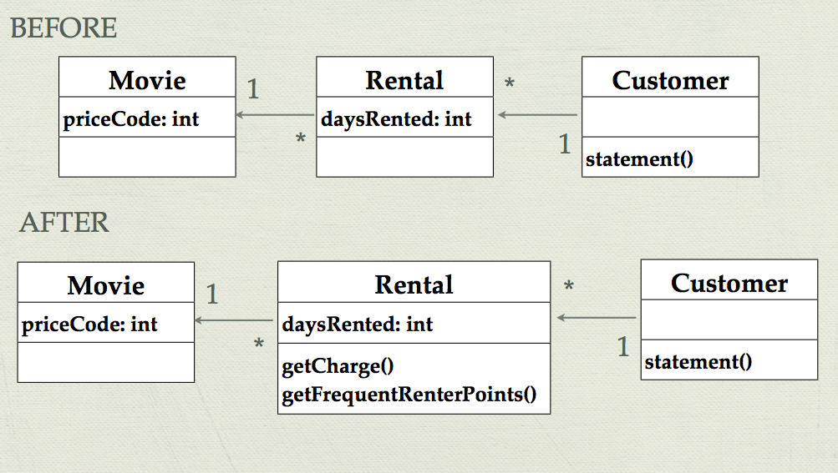
Example Outline
Use refactoring to modify the Movie rental example.
Notes:
Recap of the example from chapter 1 of Martin Fowler’s Refactoring book.

Slide 10
Refactoring steps
The example uses the following Refactorings:
Extract Method
Move Method
Replace Temp with Query
Full details are in the book, and a summary is available online:
http://refactoring.com/catalog/

Slide 11
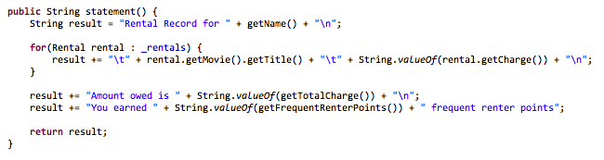
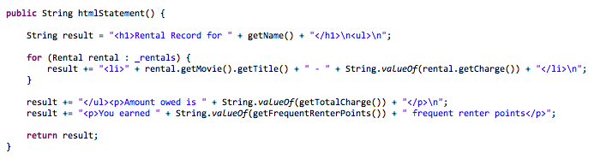

Slide 12
Refactor
Red
Green
Refactor

Slide 13
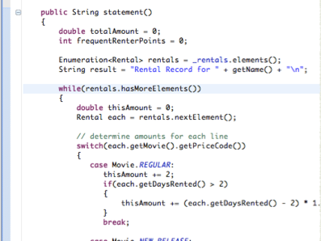
“Any fool can write code that a computer can understand. Good programmers write code that humans can understand.”
Martin Fowler, Refactoring. Improving the design of existing code. Addison Wesley, 1999

Slide 14
When do the developers create the design in an Agile project?
In XP (eXtreme Programming), it happens in different ways:
A project is arranged in iterations – the team commits to add new functionality on each iteration
At the start of the iteration, there is discussion in the team about the design for the new features and any possible changes to the existing code
Developers talk in pairs – discussing the design as they add tests and code and review the new code
There is daily stand-up meeting each day – a place to ask for ideas about design issues
Work on refactoring
Team interactions during the iteration

Slide 15
When do the developers create the design in an Agile project?
In XP, there is often not a written design specification
Some people think that is a bad way to build software
This doesn’t mean that an XP cannot write details about the design, but the focus is on working code.
Let’s look at the Agile Manifesto

Slide 16
Manifesto for Agile Software Development
We are uncovering better ways of developing software by doing it and helping others do it. Through this work we have come to value:
Individuals and interactions over processes and tools
Working software over comprehensive documentation
Customer collaboration over contract negotiation
Responding to change over following a plan
That is, while there is value in the items on the right, we value the items on the left more.
Kent Beck, Mike Beedle, Arie van Bennekum, Alistair Cockburn, Ward Cunningham, Martin Fowler, James Grenning, Jim Highsmith, Andrew Hunt, Ron Jeffries, Jon Kern, Brian Marick, Robert C. Martin, Steve Mellor, Ken Schwaber, Jeff Sutherland, Dave Thomas
© 2001, the above authors • Taken from http://agilemanifesto.org/

Slide 17
Designing to make it easier to test the software
As we write code, we should think about how easy it is to test
Shorter methods and functions – less complexity
Code with low coupling and high cohesion
Separating application logic out of the user interface code

Slide 18
Designing to make it easier to test the software
In Java, we can use Interfaces to make it easier to test
With Interfaces we can create Test Stubs, use Mocking and reduce the coupling in the software
Dependency Injection – the ability to set the DOC that an SUT might use
This means that we can swap the real DOC for one that makes it easier to test – e.g. Test Doubles.

Slide 19
Design, Testing and Agile
Agile projects take a different approach to building software and organising the team
Not as much documentation
Emphasis on working code and tests for that code
Different Agile approaches – we have looked at some ideas from XP
Aim to develop design with information we have about requirements – be prepared to change - use tools to support this

Slide 20
Any Questions?

